Slide 1
Introduction to FPGA

Slide 2

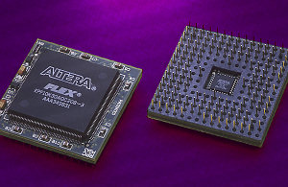
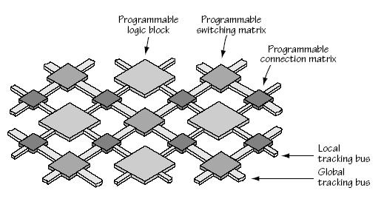
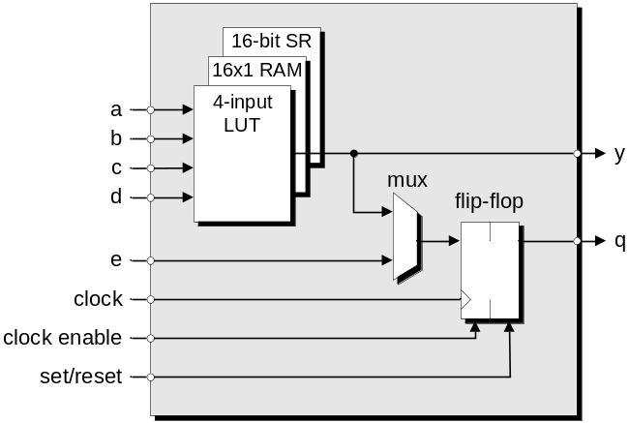
Field Programmable Gate Arrays
FPGA Fabric
Logic Block

Slide 3
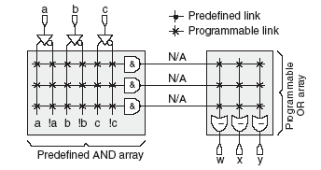
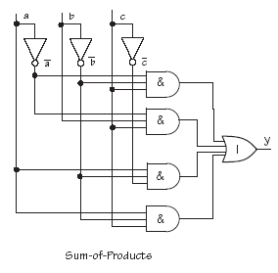
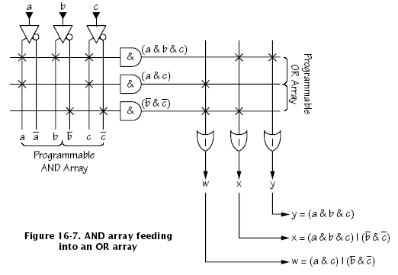
Field Programmable Gate Arrays

Slide 4
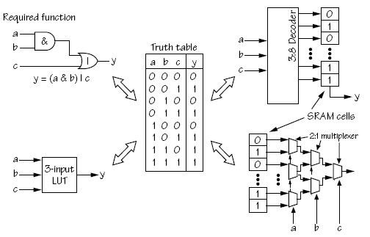
Field Programmable Gate Arrays

Slide 5
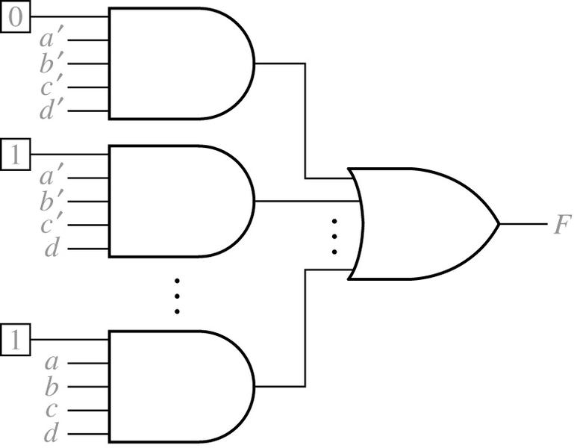
Field Programmable Gate Arrays
Implementation of a Lookup Table (LUT)
a | b | c | d |  | f
0 0 · · 1 | 0 0 · · 1 | 0 0 · · 1 | 0 1 · · 1 |  | 0 1 · · 1

Slide 6
Field Programmable Gate Arrays

Slide 7
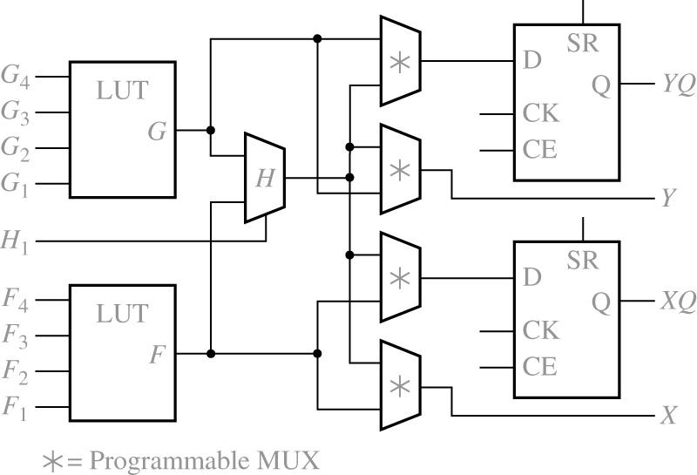
Field Programmable Gate Arrays
Simplified Configurable Logic Block (CLB)

Slide 8
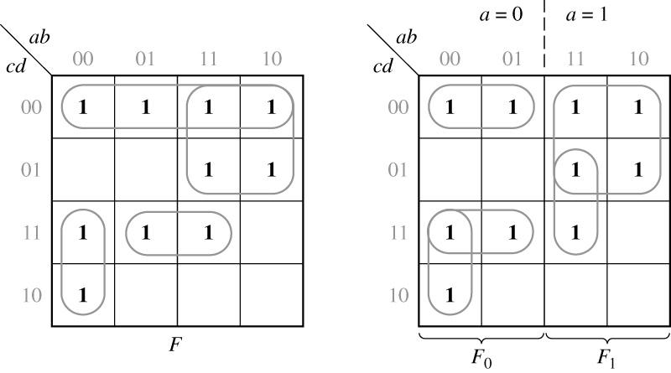
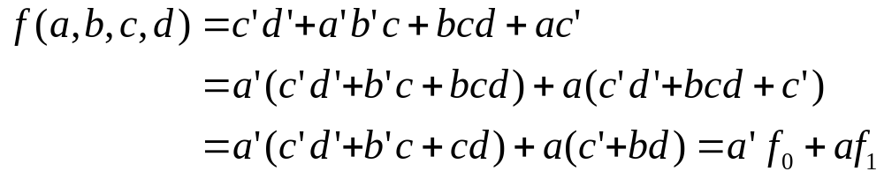
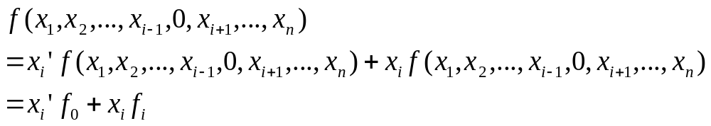
Field Programmable Gate Arrays
Decomposition of switching Functions

Slide 9
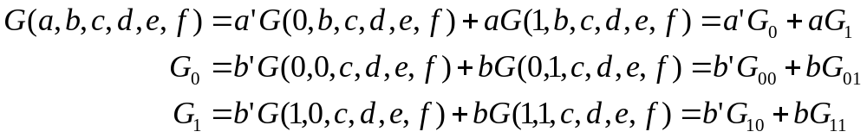
Field Programmable Gate Arrays
Decomposition of switching Functions

Slide 10
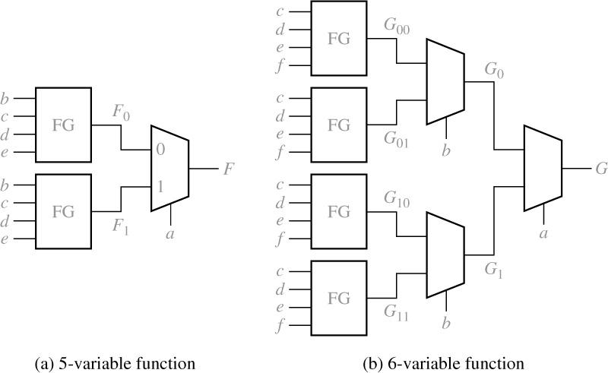
Field Programmable Gate Arrays
Realization of Five- and Six-Variable Functions with Function Generators

